Slide 1



Dataverse - Fabric Link & Fabric Data Warehouse
+
Rich Business Data for AI transformation
Scott Sewell | Microsoft
Fabric CAT, Principal Program Manager
/MScottSewell

Slide 2



Introducing Mirrored Dataverse
+
More ways to enable Link to Fabric …
Dataverse→Lakehouse
Dataverse
Short-cuts
Power BI
Import Semantic Models
Raw
Curated

Slide 3
Introducing Mirrored Dataverse
+
More ways to enable Link to Fabric …
Dataverse→Lakehouse
Dataverse
Short-cuts
Views
Power BI
Import Semantic Models
Raw
Enriched
Curated

Slide 4
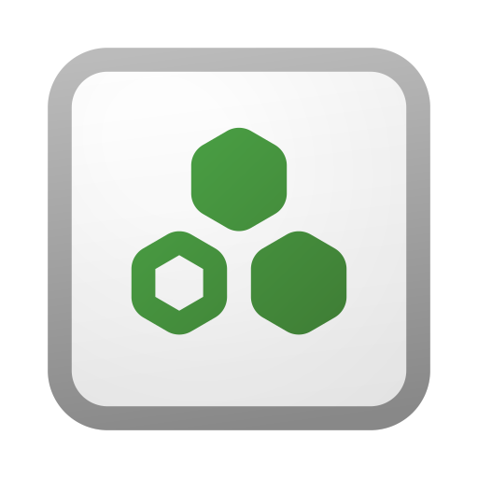


Introducing Mirrored Dataverse
+
More ways to enable Link to Fabric …
Dataverse→DataWarehouse
Fabric Data Agents
Dataverse
Copy Job
Shortcuts
Views
Curated Tables
DirectLake Semantic Models
Power BI
Raw
Enriched
Curated

Slide 5
Introducing Mirrored Dataverse
+
More ways to enable Link to Fabric …
Consumption Workspace(s)
Curated Tables
Fabric Data Agents
DirectLake Semantic Models
Engineering Workspace
Power BI
Consumption Workspace(s)
Dataverse
Shortcuts
Views
Curated Tables
Fabric Data Agents
DirectLake Semantic Models
Power BI
Raw
Enriched
Curated

Slide 6
Introducing Mirrored Dataverse
+
More ways to enable Link to Fabric …
Functional Workspace(s)
Fabric Data Agents
Copy Job or Pipelines etc
Shortcuts
Views
Curated Tables
DirectLake Semantic Models
Dataverse
Power BI
Functional Workspace(s)
Fabric Data Agents
Copy Job or Pipelines etc
Shortcuts
Views
Curated Tables
DirectLake Semantic Models
Power BI

